Slide 1
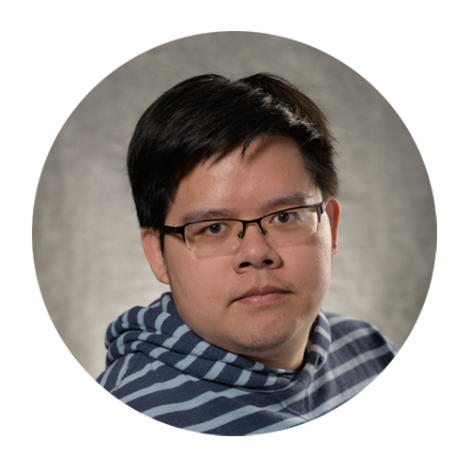
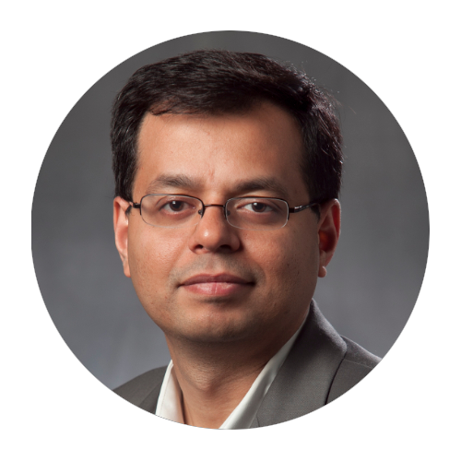
Understanding Generative Models (using pictures, intuitions, and equations)
Yu-lin Wei (UIUC)
Romit Roy Choudhury (UIUC)

Slide 2
Caveats
We are new to ML and we may not be able to explain the ideas with great clarity. Please ask questions.
2. Diverse audience … so difficult to find the correct balance between pictures, intuition, and math.
Please slow us down, speed us up.

Slide 3
Roadmap
The whole tutorial in a nutshell (only pictures and intuitions)
Quick probability warmup (Bayes, MLE, EM)
Latent variable models: AE, VAE and visualization
Hierarchical VAE to Diffusion
Diffusion take 2: Score based models
GAN
Normalizing flows
Wrap up
30m
30m
45m
60m
30m
15m
15m
10m
~ 4 hours

Slide 4
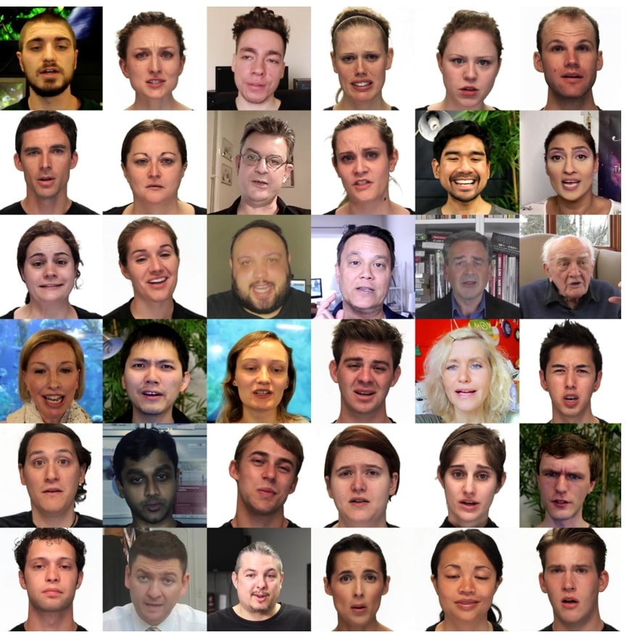
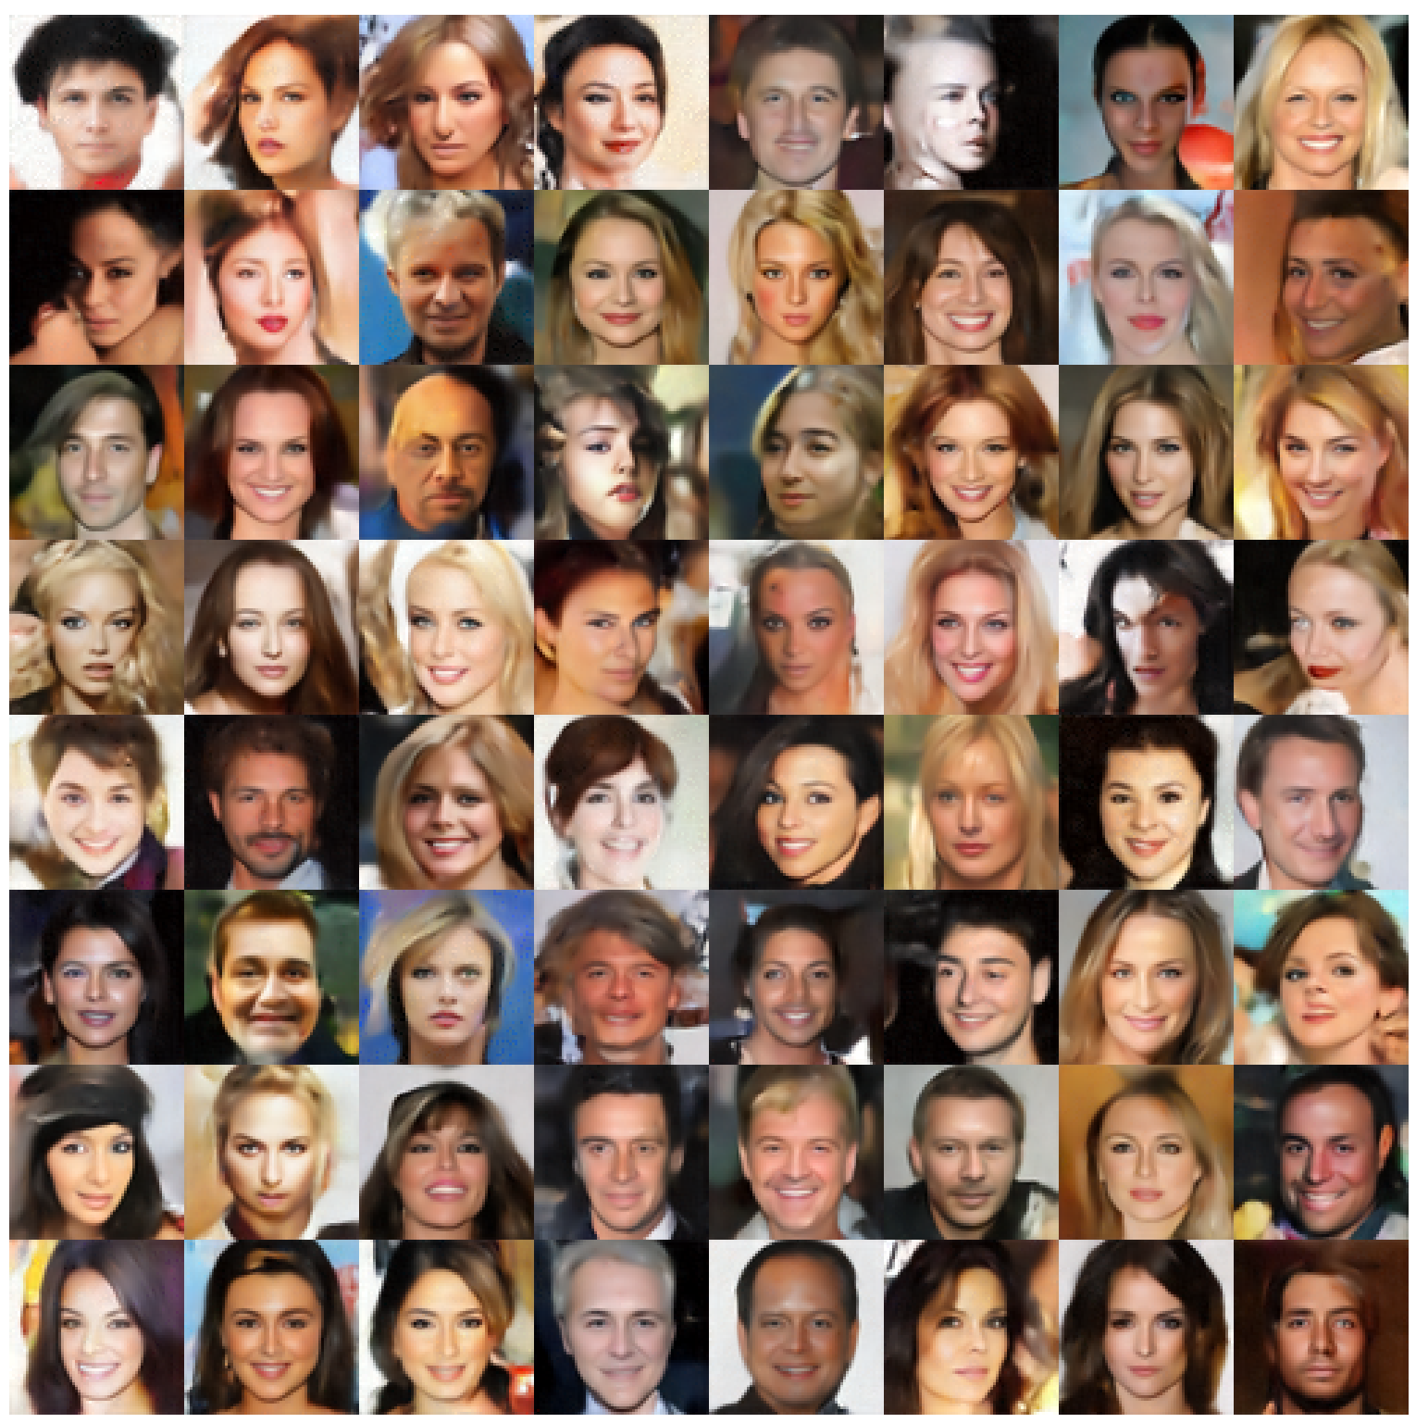
End goal …
Generative
Models
Example
data
Previously unseen,
realistic data
Let’s formulate the problem with pictures and intuitions

Slide 5
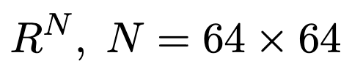
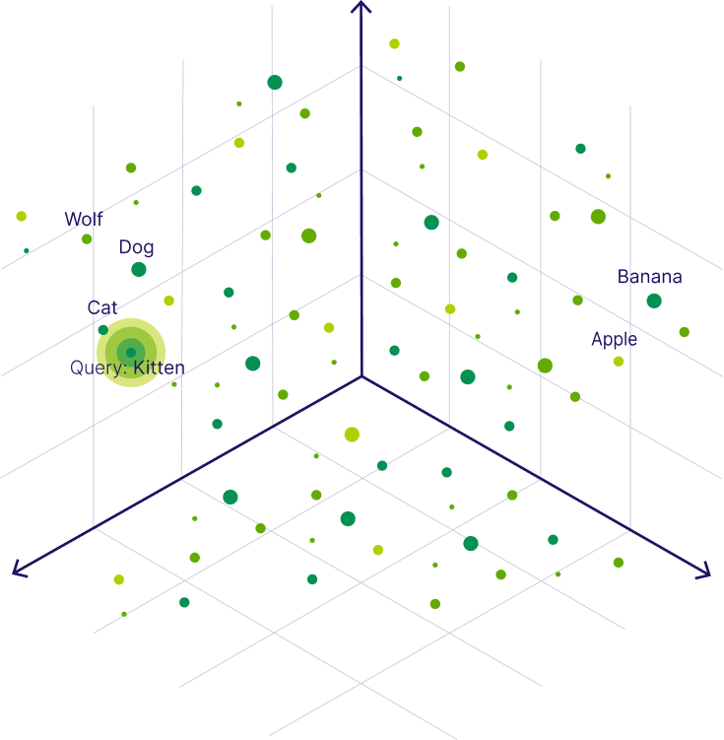
Images are points in high dimensional space
But such data are extremely sparse

Slide 6
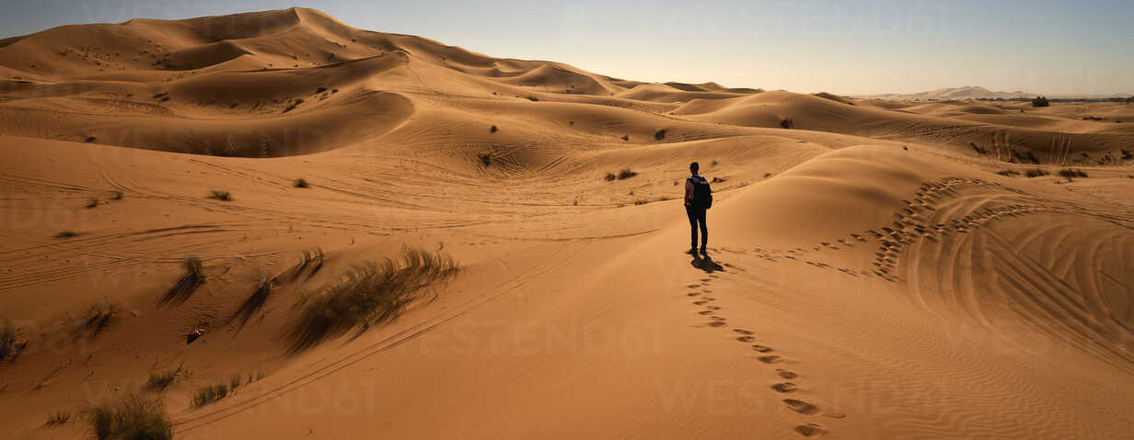
Images are points in high dimensional space
But such data are extremely sparse (diamonds scattered in a 4000-dim desert)

Slide 7
Images are points in high dimensional space
But such data are extremely sparse (diamonds scattered in a 4000-dim desert)
If you find an image, you will find a cluster and thin trails of images → a manifold

Slide 8
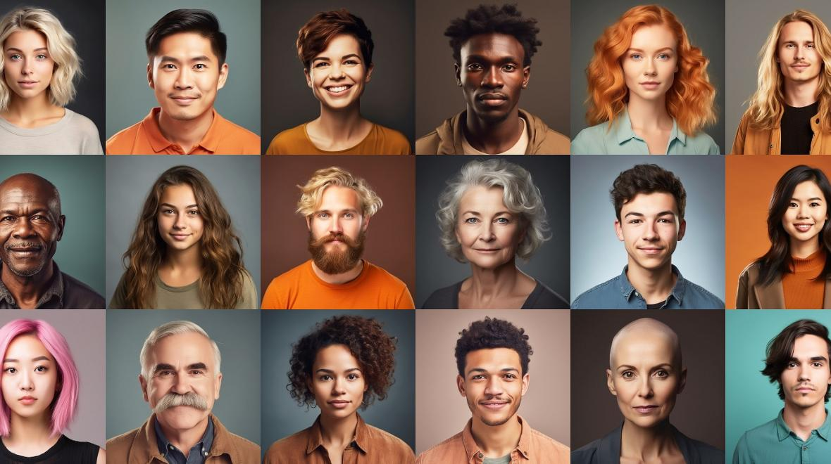
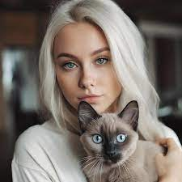
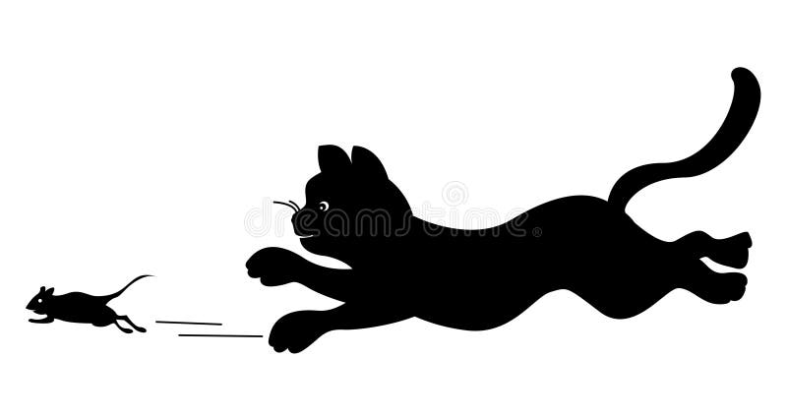

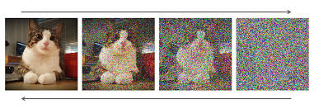
Images are points in high dimensional space
But such data are extremely sparse (diamonds scattered in a 4000-dim desert)
If you find an image, you will find a cluster and thin trails of images → a manifold

Slide 9
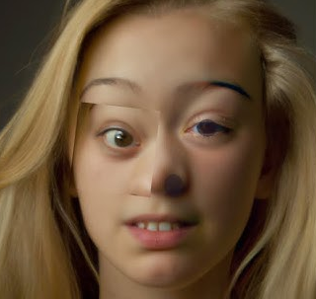
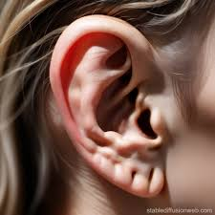
Images are points in high dimensional space
But such data are extremely sparse (diamonds scattered in a 4000-dim desert)
If you find an image, you will find a cluster and thin trails of images → a manifold

Slide 11
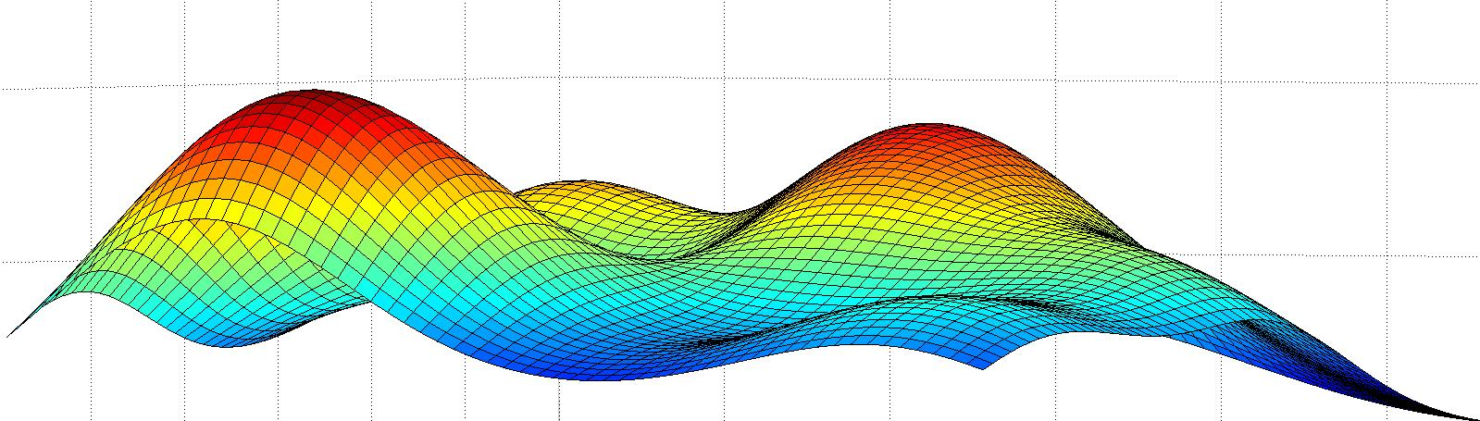
Fit a (probability density) function over these images

Slide 12
End goal …
Generative
Models
Example
data
Previously unseen,
realistic data

Slide 13
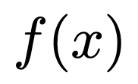
Fit a (probability density) function over these images
But how do you fit a function? Infinite number of functions can fit the data.

Slide 14
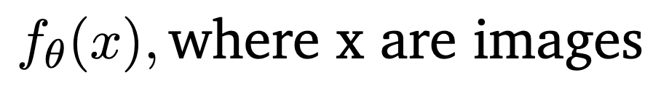
Fit a (probability density) function over these images
But how do you fit a function? Infinite number of functions can fit the data.
One idea: Maximize likelihood over a family of functions

Slide 15
But how do you fit a function? Infinite number of functions can fit the data.
One idea: Maximize likelihood over a family of functions
And that brings up many questions:

Slide 16
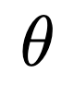
But how do you fit a function? Infinite number of functions can fit the data.
One idea: Maximize likelihood over a family of functions
And that brings up many questions:
How do you choose without over or under fitting?
How do you ensure that is a normalized probability distribution?
How do you sample from a complex distribution (without an analytical form)?
Even if you sample, you get most samples from high probability modes → where is the generative-ness?
If you sample points far from training data and the image looks real → is that hallucination?

Slide 17
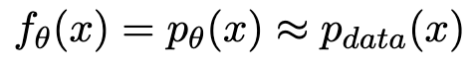
Bottom line:
We want:
Assuming we have enough data
to represent the data distribution
Generative models want to ideally learn, or at least sample, from

Slide 18
Bottom line:
We want:
Assuming we have enough data
to represent the data distribution
Generative models want to ideally learn, or at least sample, from
Solution
Landscape:
VAE
GAN
Flows
Diffusion

Slide 19
Latent Space Models (AE and VAE)

Slide 20
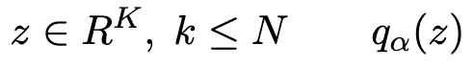
Latent Space Models (AE and VAE)
All images have a latent set of rules from which they are generated.
Learning the distribution over the rules is all we need.
Why? Because we can sample from the rules distribution
and generate images based on those sampled rules.

Slide 21
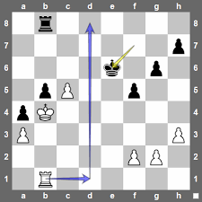
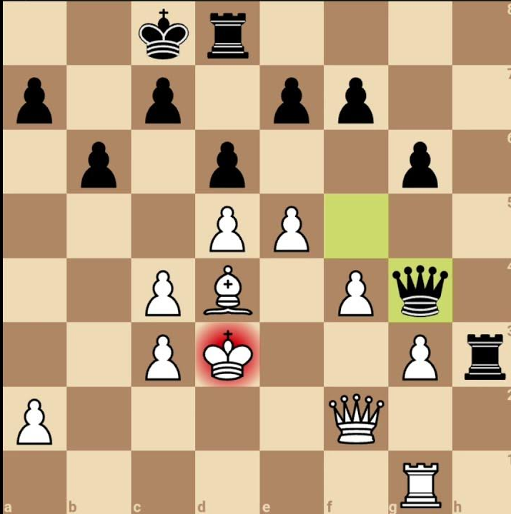
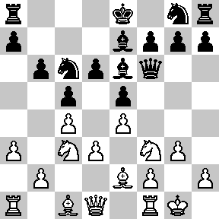
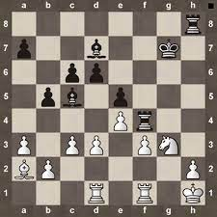
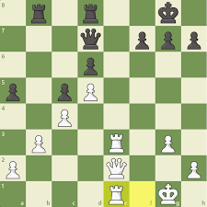
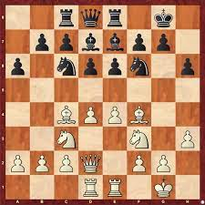
Latent Space Models (AE and VAE)
All images have a latent set of rules from which they are generated.
Learning the distribution over the rules is all we need.
Why? Because we can sample from the rules distribution
and generate images based on those sampled rules.
Example:
You have many examples of incomplete chess game images.
Can you generate more such images that are correct.

Slide 22
Latent Space Models (AE and VAE)
All images have a latent set of rules from which they are generated.
Learning the distribution over the rules is all we need.
Why? Because we can sample from the rules distribution
and generate images based on those sampled rules.
Example:
You have many examples of incomplete chess game images.
Can you generate more such images that are correct.
Answer: Let’s try to learn the rules of chess? If possible, then sample from the rules, and position pieces.
All images will be consistent (black bishop always in white square)

Slide 23
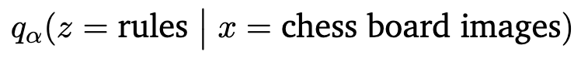
Mathematically, we want to learn conditional distribution:

Slide 24
Mathematically, we want to learn conditional distribution:
Taking Expectation over all images:

Slide 25
Mathematically, we want to learn conditional distribution:
Taking Expectation over all images:
Finally, sample rules from and Decode rules to images

Slide 26
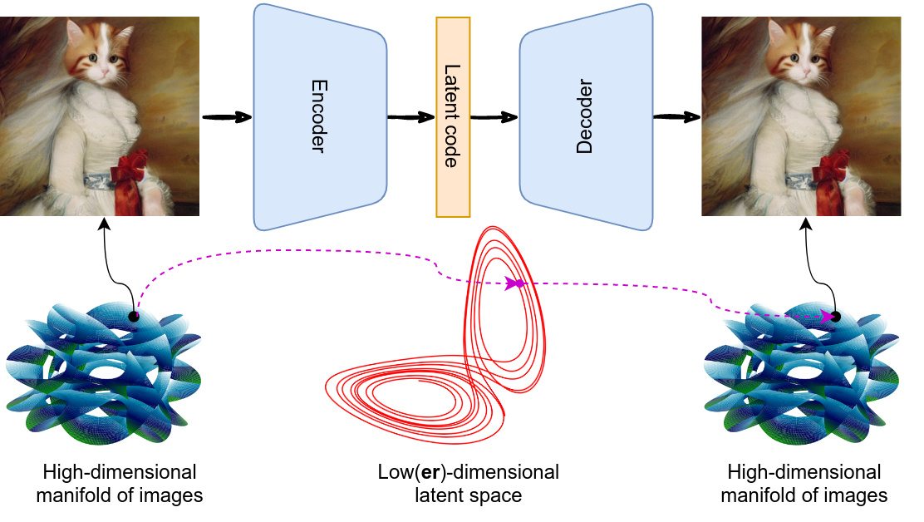
Mathematically, we want to learn conditional distribution:
Taking Expectation over all images:
Finally, sample rules from and Decode rules to images

Slide 27
Mathematically, we want to learn conditional distribution:
Taking Expectation over all images:
Finally, sample rules from and Decode rules to images
Train with
self supervision

Slide 28
VAE
(Variational AutoEncoder)
We will dive into details … but need some prerequisites/refresher in
Probability:
Bayes, Multi-variates, MLE, Expectation Maximization (EM)
Linear Algebra:
Eigen decomposition, PCA, SVD

Slide 29
Implicit Density Models (GANs)

Slide 30
Implicit Density Models (GANs)
Why worry about learning or
We don’t need those distributions. We just need to generate samples (who cares about their probability values)

Slide 31
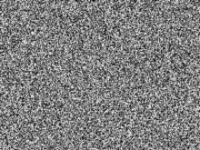
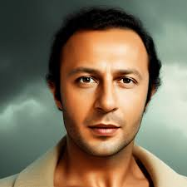
Implicit Density Models (GANs)
Why worry about learning or
We don’t need those distributions. We just need to generate samples (who cares about their probability values)
Learn to transform samples from one sample-able distribution to true data distribution

Slide 32
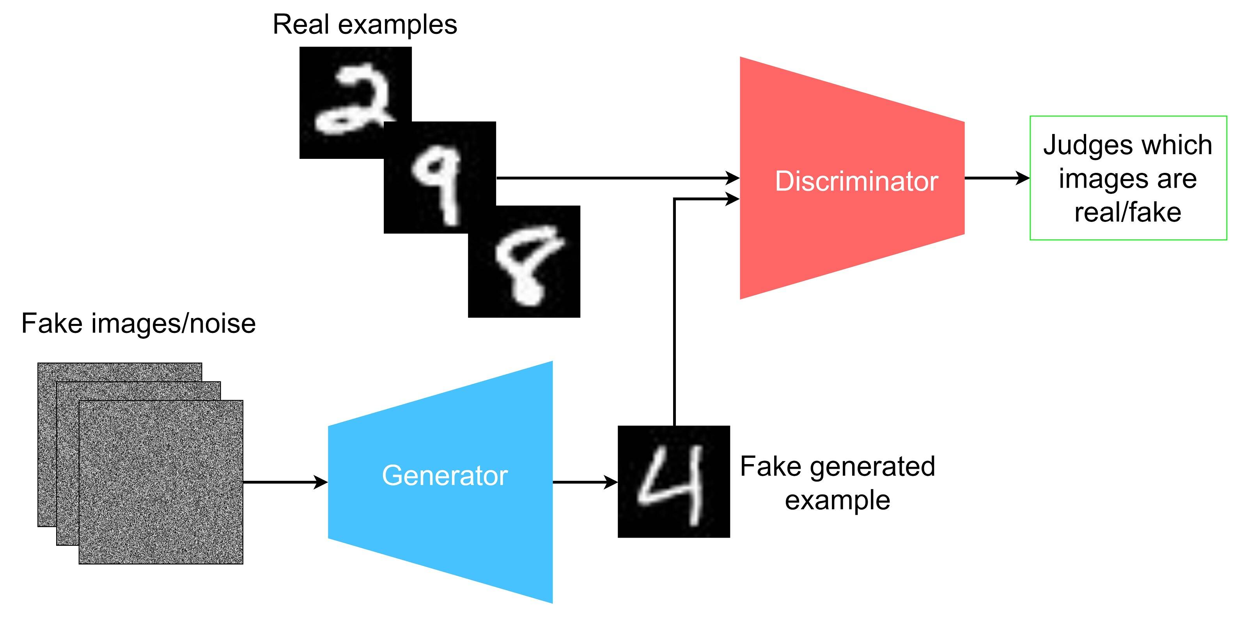
Implicit Density Models (GANs)
Why worry about learning or
We don’t need those distributions. We just need to generate samples (who cares about their probability values)
So here is an idea to generate samples without explicitly learning the distribution:
Fake

Slide 33
Implicit Density Models (GANs)
Why worry about learning or
We don’t need those distributions. We just need to generate samples (who cares about their probability values)
So here is an idea to generate samples without explicitly learning the distribution:
True images
Fake

Slide 34
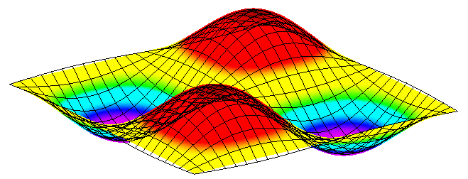
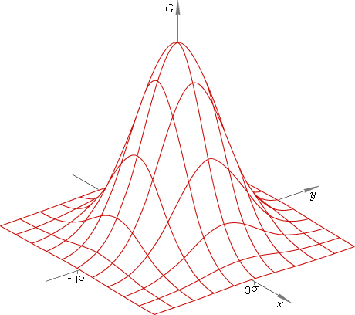
Implicit Density Models (GANs)
Why worry about learning or
We don’t need those distributions. We just need to generate samples (who cares about their probability values)
So here is an idea to generate samples without explicitly learning the distribution:
True images
Fake

Slide 35
Implicit Density Models (GANs)
Why worry about learning or
We don’t need those distributions. We just need to generate samples (who cares about their probability values)
So here is an idea to generate samples without explicitly learning the distribution:
The density has been learnt implicitly → not by MLE but by forcing competition between G and D
True images
Fake

Slide 36
Generative
Models
Example
data
True images
Generative
Models
Previously unseen,
realistic data

Slide 37
Normalizing Flows

Slide 38
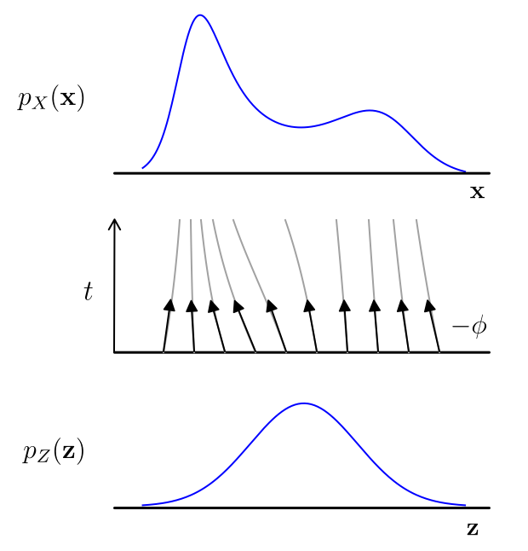
Normalizing Flows
With GANs, we don’t have a handle on the
target distribution (i.e., the trajectories can be arbitrary)
GANs
But wait, math department knows how to transform
one (invertible) distribution to another and vice versa. →

Slide 39
Normalizing Flows
With GANs, we don’t have a handle on the
target distribution (i.e., the trajectories can be arbitrary)
GANs
But wait, math department knows how to transform
one (invertible) distribution to another and vice versa. →
Can’t we learn a 1:1 mapping from noise to images?
Why? What’s the gain?

Slide 40
Normalizing Flows
With GANs, we don’t have a handle on the
target distribution (i.e., the trajectories can be arbitrary)
GANs
But wait, math department knows how to transform
one (invertible) distribution to another and vice versa. →
Can’t we learn a 1:1 mapping from noise to images?
Why? What’s the gain?
Oh, I can then compute probability of each image.

Slide 41
Normalizing Flows
But wait, math department knows how to transform
one (invertible) distribution to another and vice versa. →
Can’t we learn a 1:1 mapping from noise to images?
Why? What’s the gain?
Oh, I can then compute probability of each image.
Wait, what !!!! How can we compute the probability of each image?
Easy.
Step 1. Pick the image and backtrack on the trajectory to reach the sample in the starting distribution.
Step 2. Since you know the starting distribution (e.g., Gaussian), you know the probability.

Slide 42
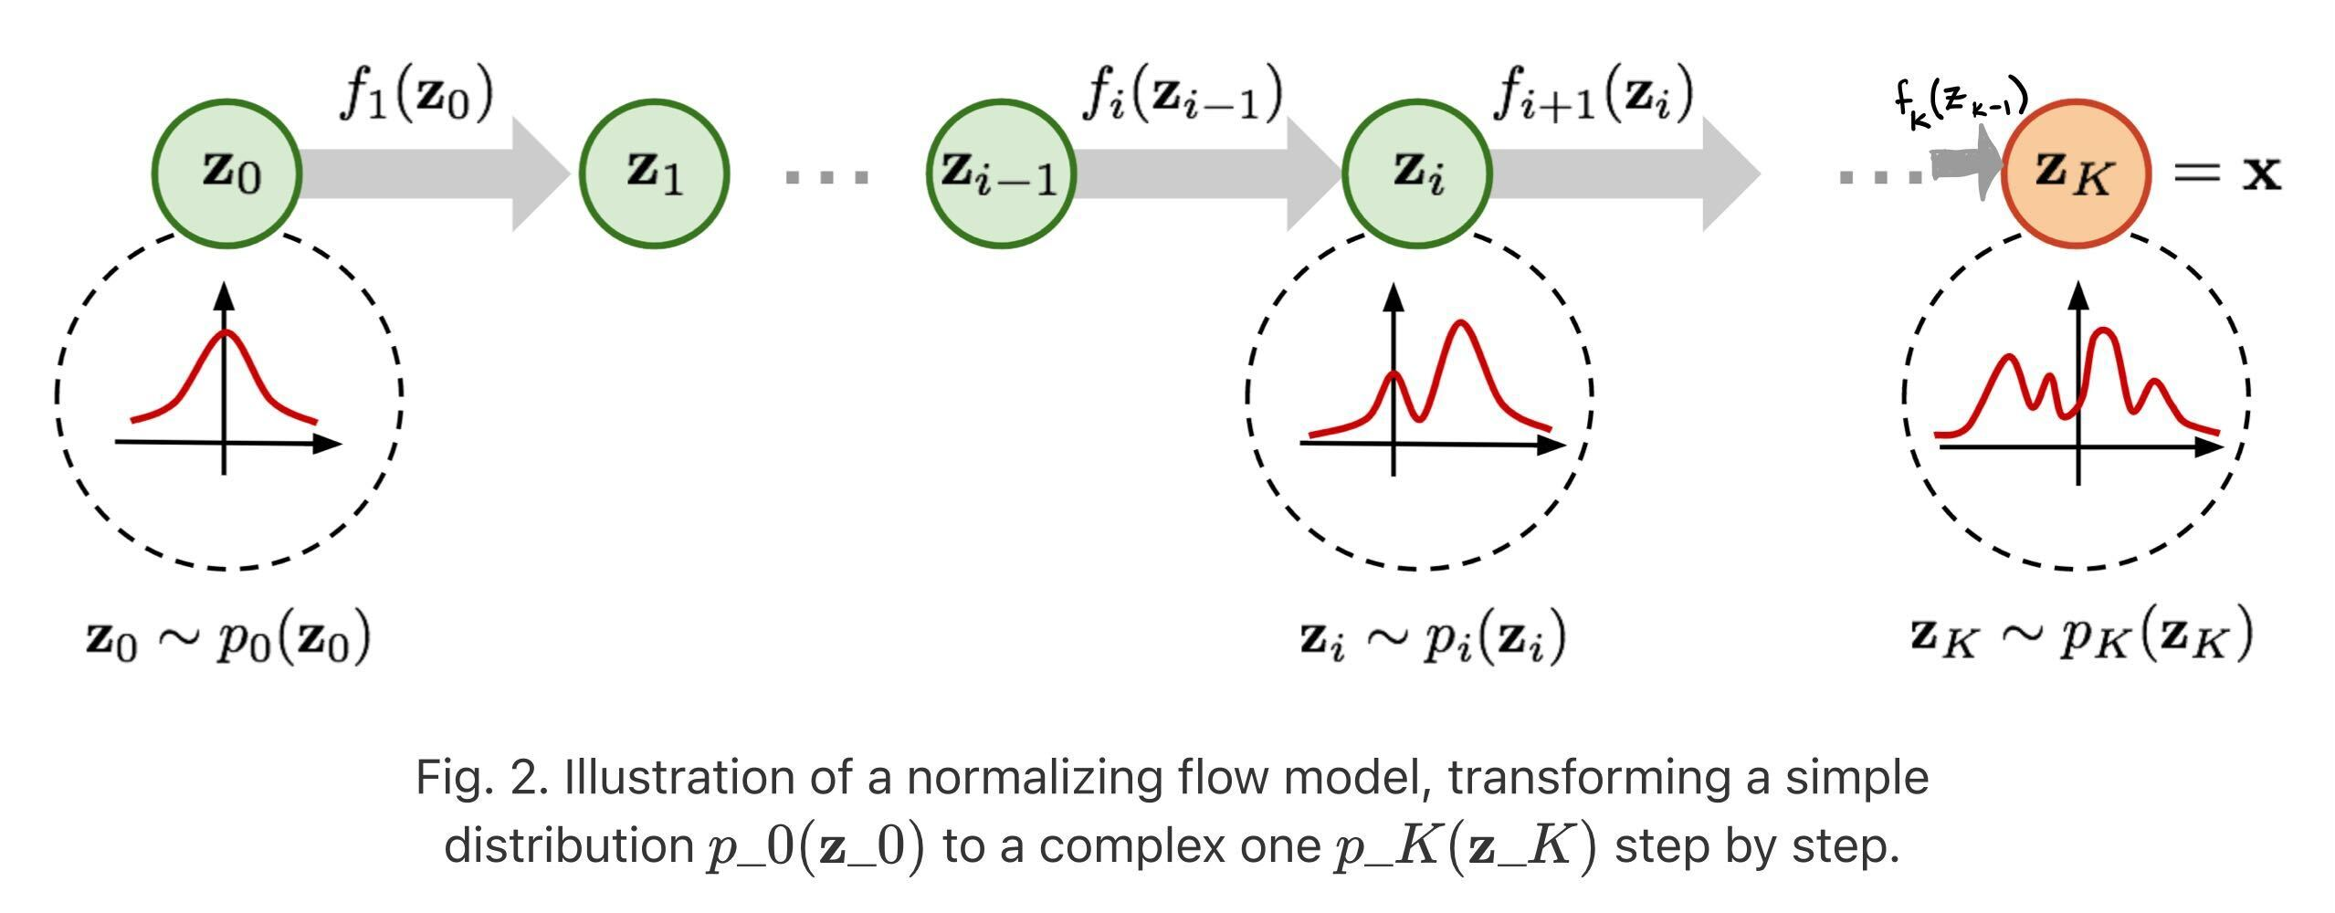
Normalizing Flows
Step 1. Pick the image and backtrack on the trajectory to reach the sample in the starting distribution.
Step 2. Since you know the starting distribution (e.g., Gaussian), you know the probability.

Slide 43
Generative
Models
Example
data
Generative
Models
Previously unseen,
realistic data

Slide 44
Generative
Models
Example
data
Generative
Models
Previously unseen,
realistic data

Slide 45
Diffusion

Slide 46
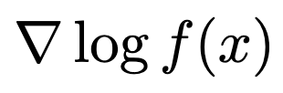
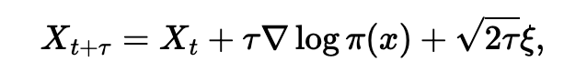
Diffusion
Hard to learn but can we sample from this function?
Given a function French physicist Paul Langevin showed how to draw samples from that function.
In plain English, Langevin said: Step 1. Start from a random initial location and do some sort of gradient ascent on
Step 2. Repeat this for many many steps
Step 3. Wherever you end up, add that sample in your sample set.
Step 4. Go to Step 1 if you have not yet collected N samples

Slide 47
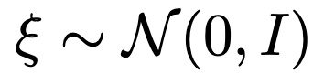
Diffusion
Hard to learn but can we sample from this function?
Given a function French physicist Paul Langevin showed how to draw samples from that function.
In plain English, Langevin said: Step 1. Start from a random initial location and do some sort of gradient ascent on
Step 2. Repeat this for many many steps
Step 3. Wherever you end up, add that sample in your sample set.
Step 4. Go to Step 1 if you have not yet collected N samples
Note: This is gradient ascent on
And, the third term has a noise

Slide 48
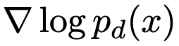
Diffusion
Hard to learn but can we sample from this function?
Given a function French physicist Paul Langevin showed how to draw samples from that function.
In plain English, Langevin said: Step 1. Start from a random initial location and do some sort of gradient ascent on
Step 2. Repeat this for many many steps
Step 3. Wherever you end up, add that sample in your sample set.
Step 4. Go to Step 1 if you have not yet collected N samples
Note: This is gradient ascent on
And, the third term has a noise
So bottom line: If I can get , then I can get samples from
Called Score function
But how do I get the score?

Slide 49
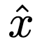
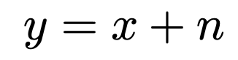
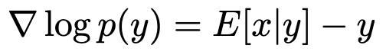
Diffusion
So bottom line: If I can get , then I can get samples from
Called Score function
But how do I get the score?
Noisify:
Can we denoise ?
What is this?
My goodness !! Score function is a denoiser, so if I train a Denoiser, I have the score.

Slide 50
Diffusion
Can we denoise ?
My goodness !! Score function is a denoiser, so if I train a Denoiser, I have the score.
I can start at a random point in image space and use score to ascend → I have real image samples

Slide 51
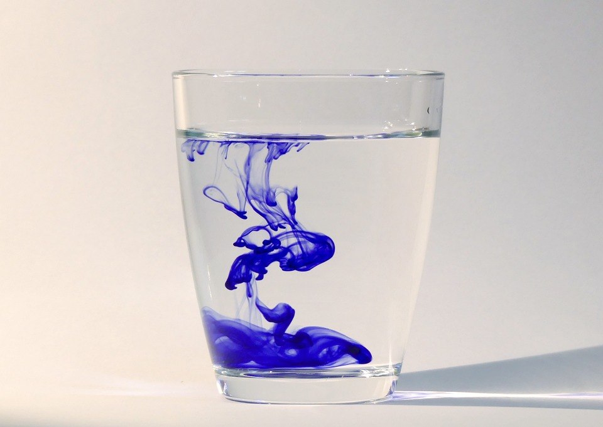
Diffusion
I can start at a random point in image space and use score to ascend → I have real image samples
Many paths of approach:
Thermodynamics (destroying structure and repairing)
Stochastic Diff. Equations (destroying process is a solution to a SDE)
Hierarchical VAE (each step is a latent representation)
Sampling from a complex density function (score models)

Slide 52
Let’s zoom out

Slide 53
Generative models want to first learn, and then sample, from
Solution
Landscape:
VAE
GAN
Flows
Diffusion

Slide 54
VAE
(Variational AutoEncoder)
GAN
(Generative Adversarial Network)
True images
Flows
Diffusion
Denoising Diffusion Probabilistic Models (DDPM)
(Normalizing Flows)

Slide 55
Questions

